Slide 1










Sexual Health Board Report
July 2024
@myhqtoronto | hqtoronto.ca | hqtoronto.ca/donate

Slide 2
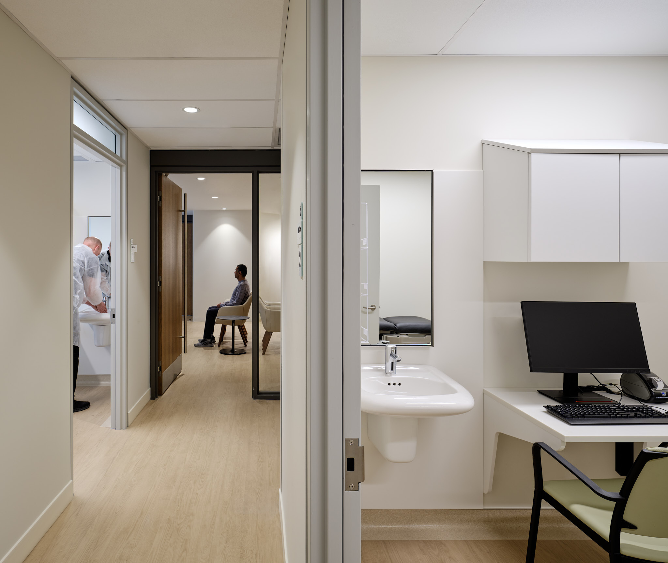
Sexual Health
Key Messages
July 2024
Highest weekly average last week
178 sexual health visits / day
Highest number of daily service users on Monday July 8, 2024 at 220 users
New visits have stabilized.
Our testing is significantly less expensive than Public Health.
Successful Code for Canada Hackathon
Idea 1:
Improve kiosk check-in process
Idea 2:
Automate mass sending of all negative results (80% of patients)
@myhqtoronto | hqtoronto.ca | hqtoronto.ca/donate

Slide 3
Testing Template
October 03, 2024
This is the first box of text, testing it right now!
Updated text 2

Slide 4

The problem
How might we make it easier for HQ Toronto patients to know where they are in the check-in and triage process so that they feel more informed?

Slide 5

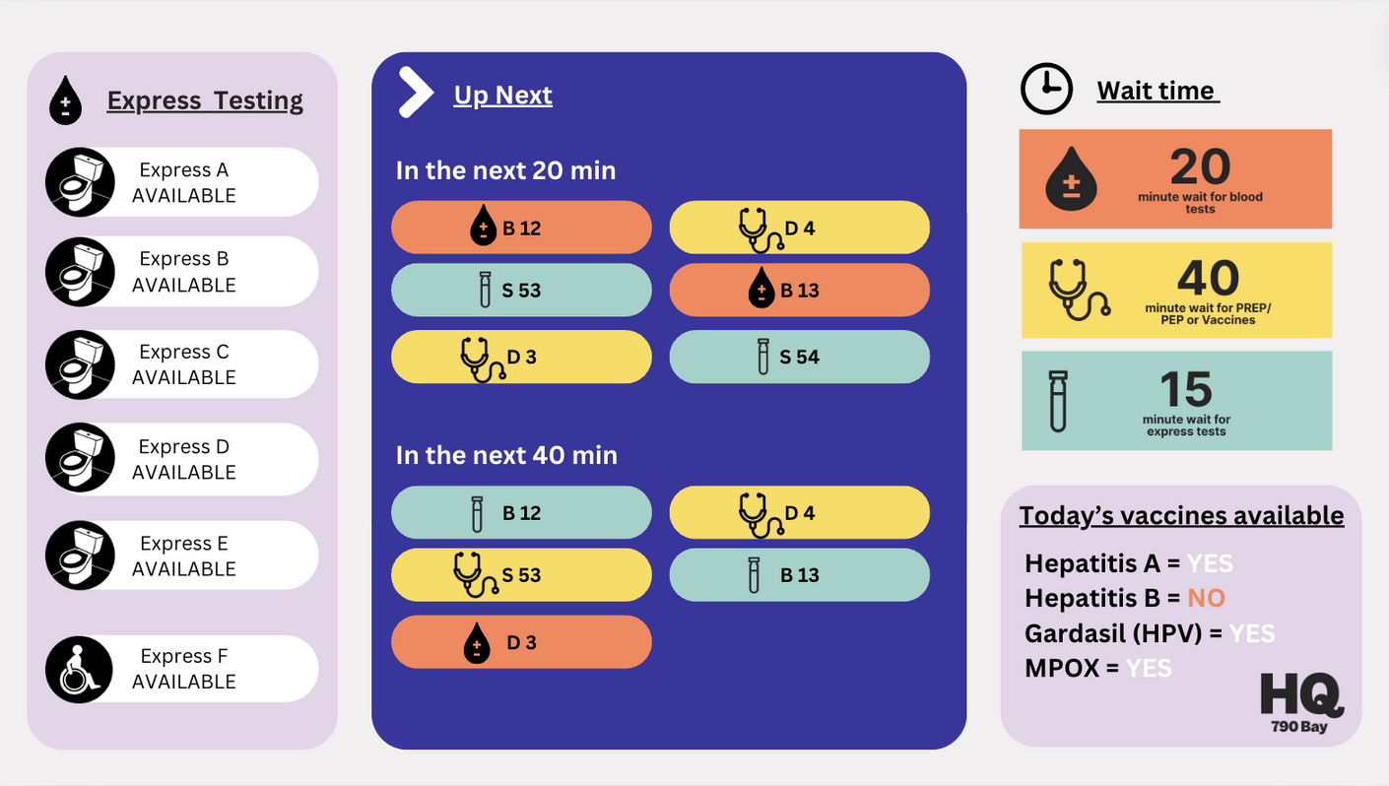
V4

Slide 6
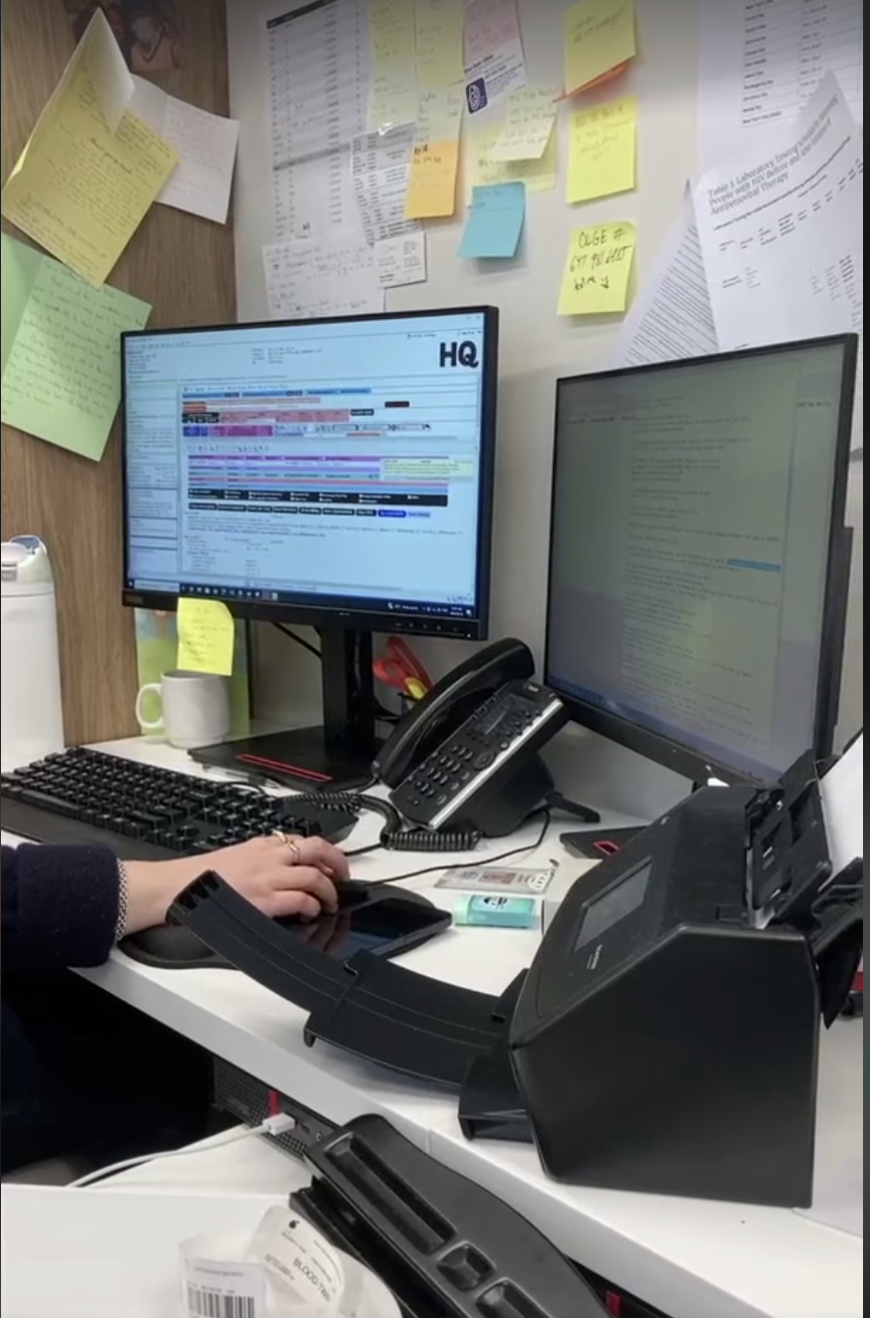

The problem
What is the problem?
Tasks nurses spend a lot of time sending negative test results to patients, which could be better used for delivering care to patients.
Why is this important?
Lead to increased employee burnout
Reduced patient care
Results not shared quickly
Reduced level of patient care

Slide 7
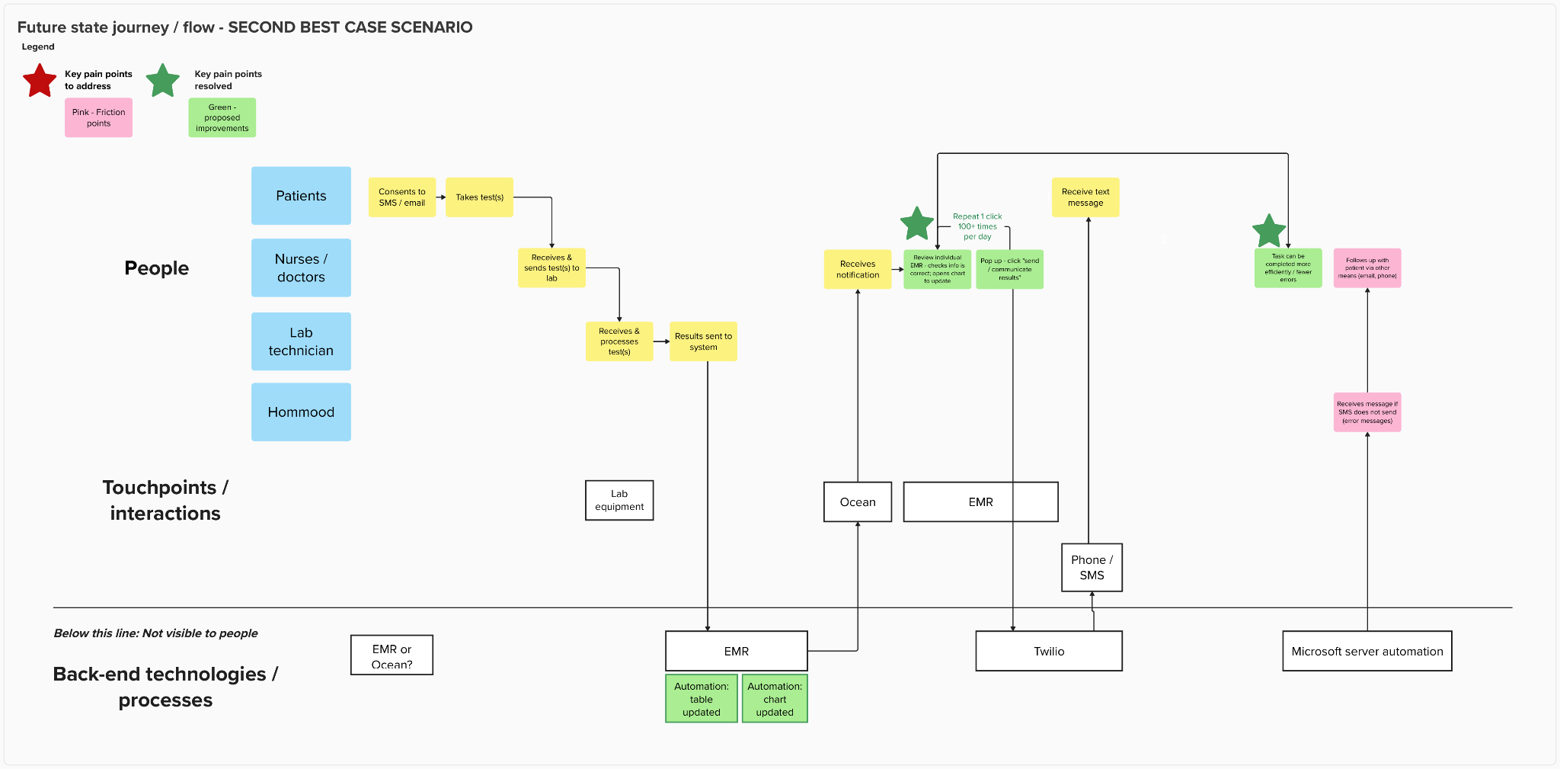
Future state: Texting a negative test result

Slide 8
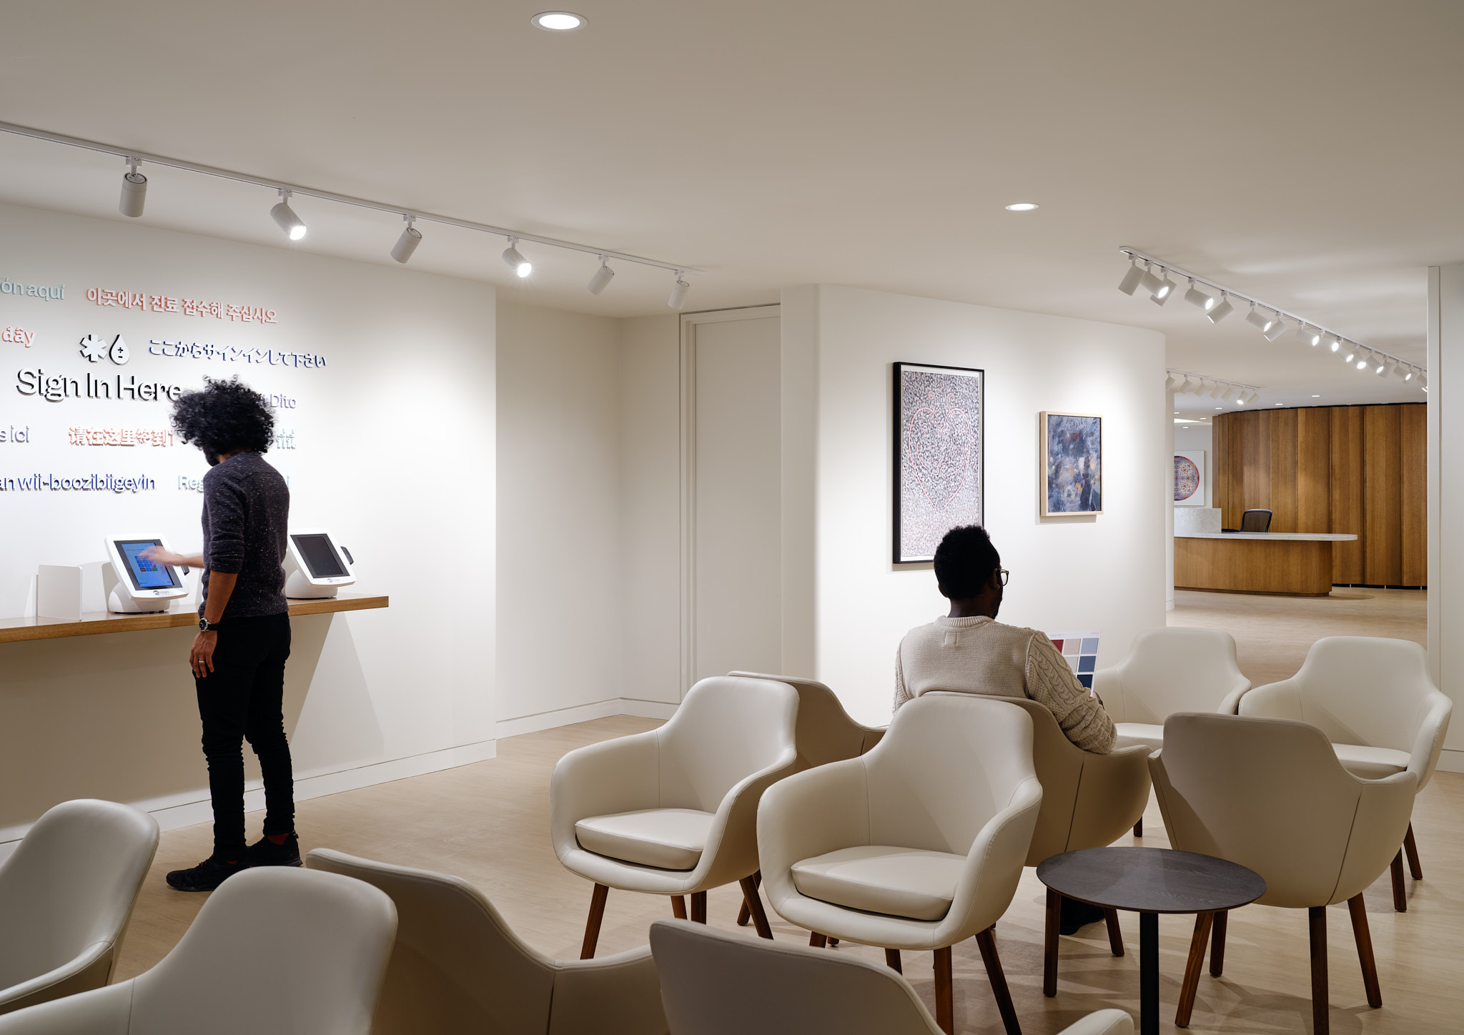
Cumulative data on sexual health visit from July 2022 to June 2024
50, 736 visits
12,246 individuals
@myhqtoronto | hqtoronto.ca | hqtoronto.ca/donate

Slide 9
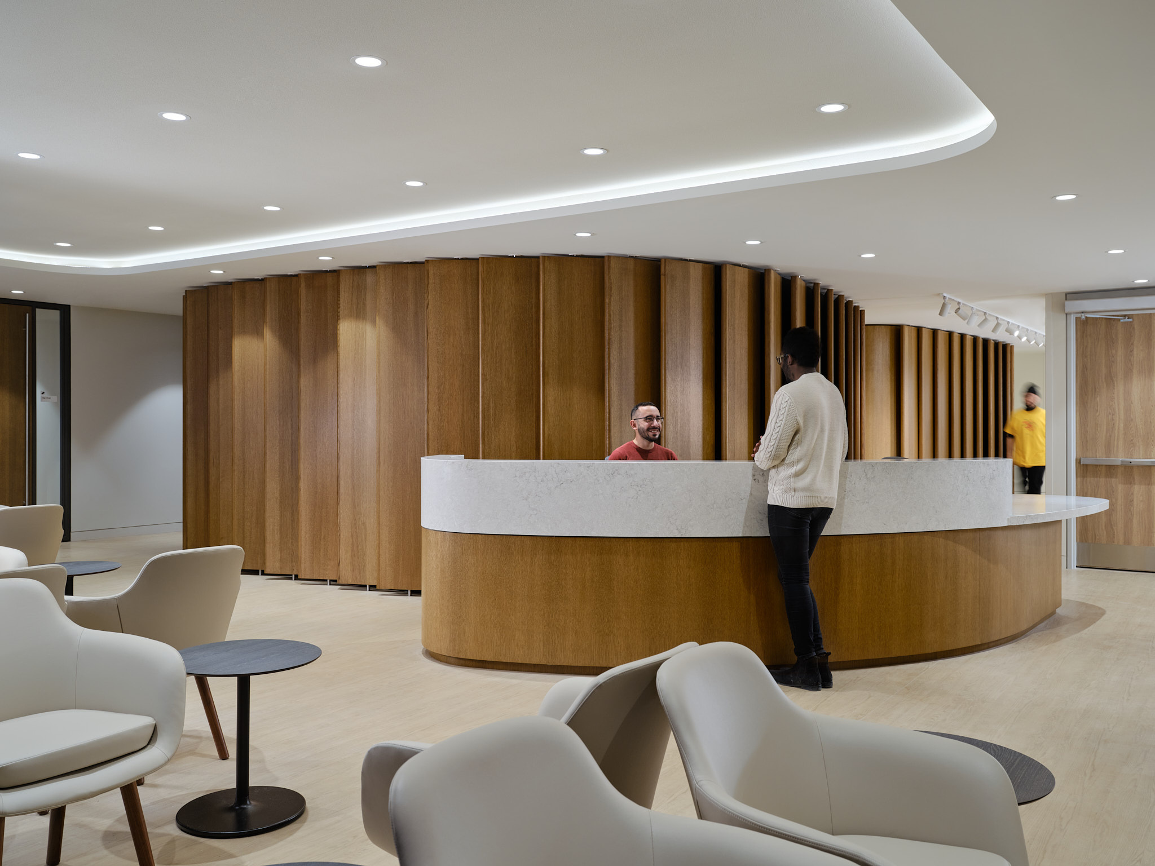
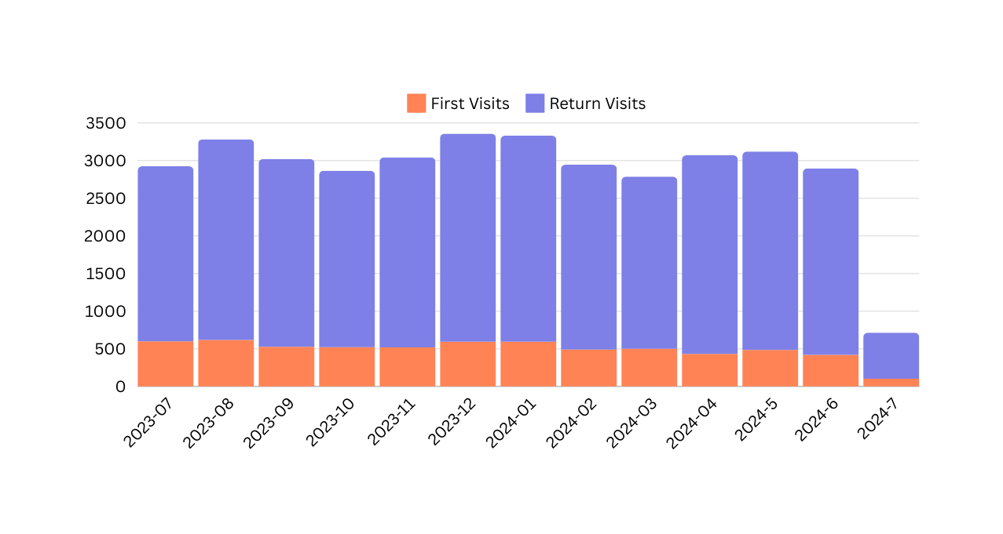
First vs Return
July 2023 - June 2024
04,725 visits in 2022
27,025 visits in 2023
18,986 visits in 2024
@myhqtoronto | hqtoronto.ca | hqtoronto.ca/donate

Slide 10
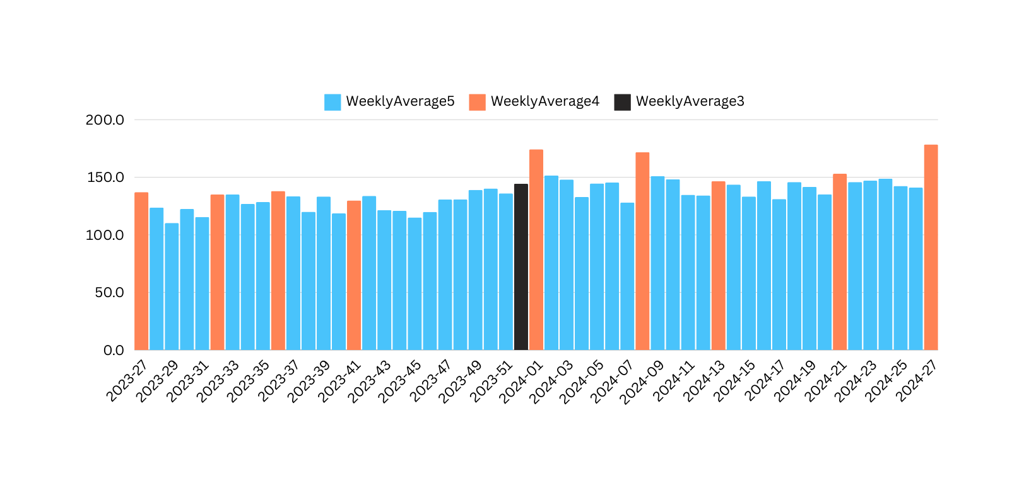
Average Weekly
July 2023 - June 2024
Christmas / Boxing Day
Canada Day
Civic Holiday
Labour Day
Thanksgiving
New Year
Family Day
Good Friday
Victoria Day
Canada Day
@myhqtoronto | hqtoronto.ca | hqtoronto.ca/donate

Slide 11






Demographics
July 2022 to
June 2024
Average age of 34
10% living with HIV
Cis men: 87%
Trans men: 0.9%
Trans women: 1.4%
Non binary: 5.6%
Other gender identity : 1.5%
@myhqtoronto | hqtoronto.ca | hqtoronto.ca/donate

Slide 12

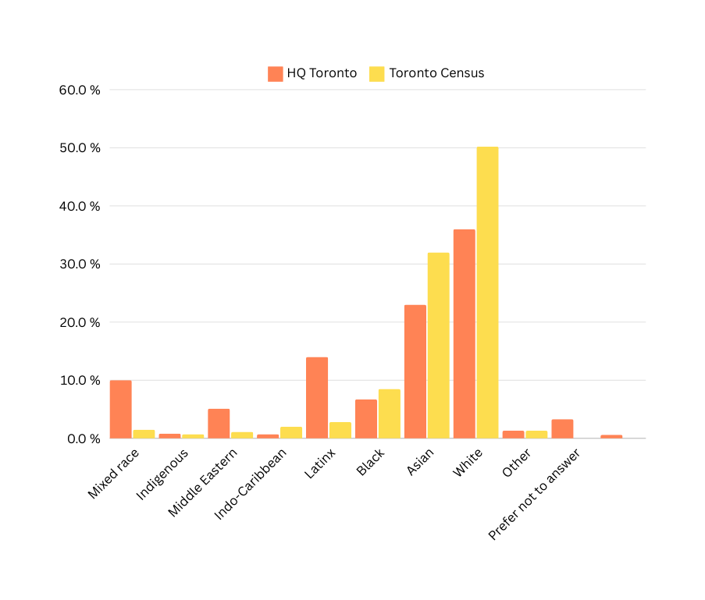
Ethnicity by individuals
July 2022 to June 2024
@myhqtoronto | hqtoronto.ca | hqtoronto.ca/donate

Slide 13
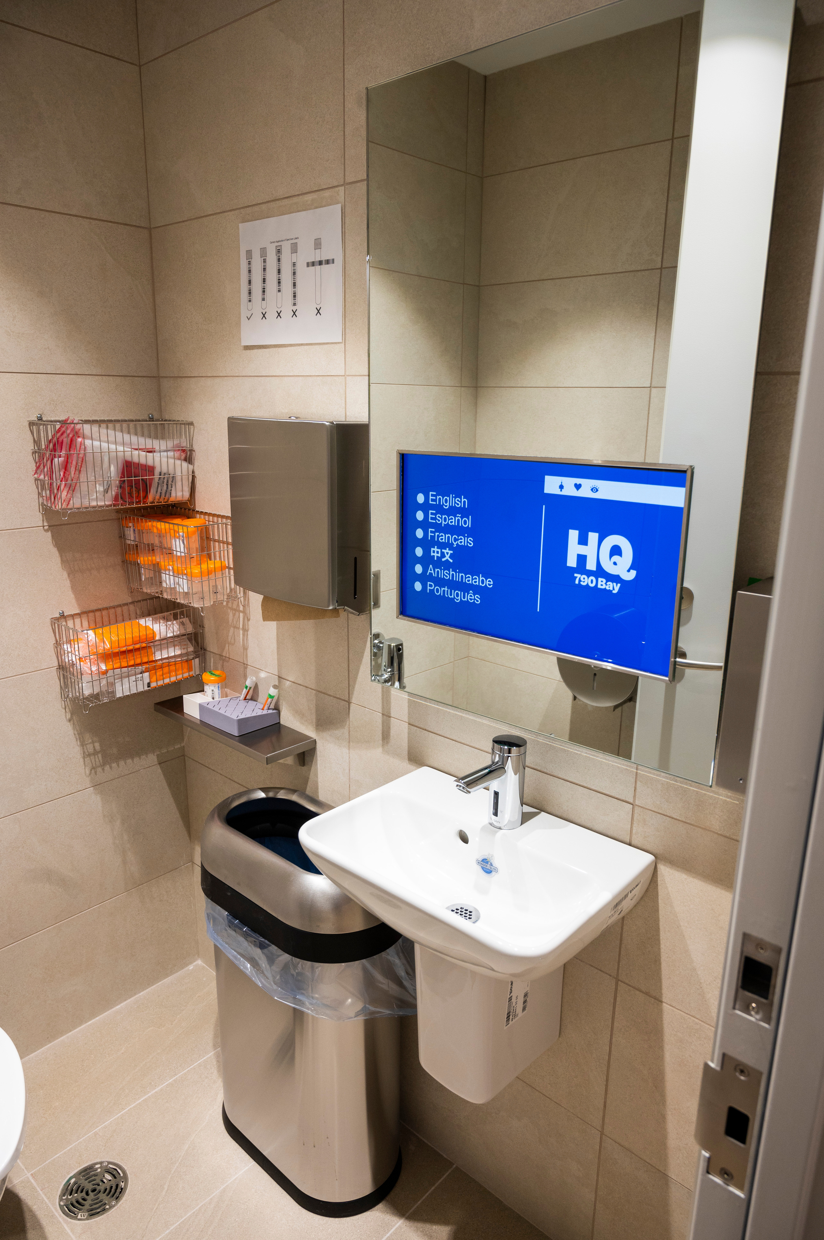
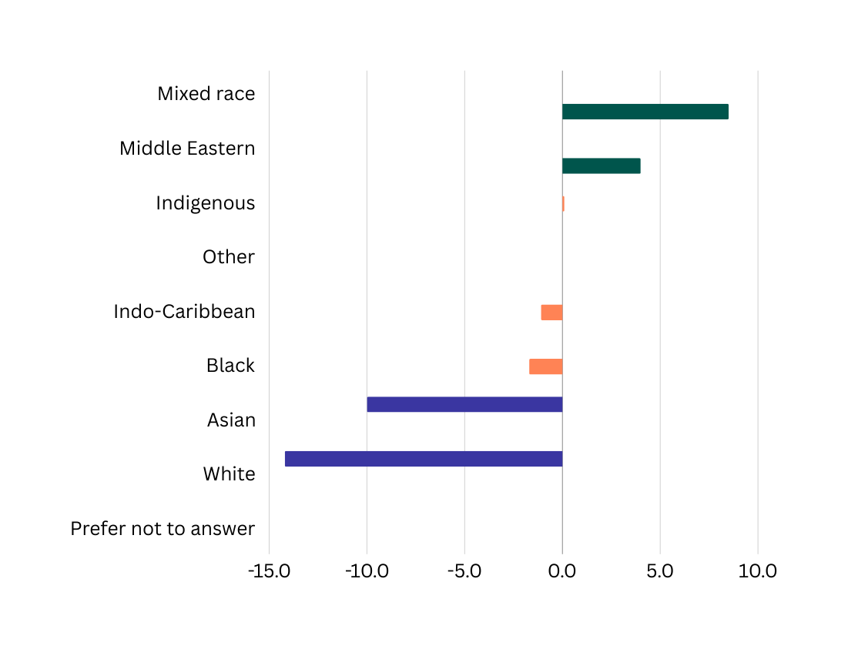
Ethnicity
(Difference between Toronto 2020 Census and HQ
<Toronto Census
= Toronto Census
> Toronto Census
@myhqtoronto | hqtoronto.ca | hqtoronto.ca/donate

Slide 14
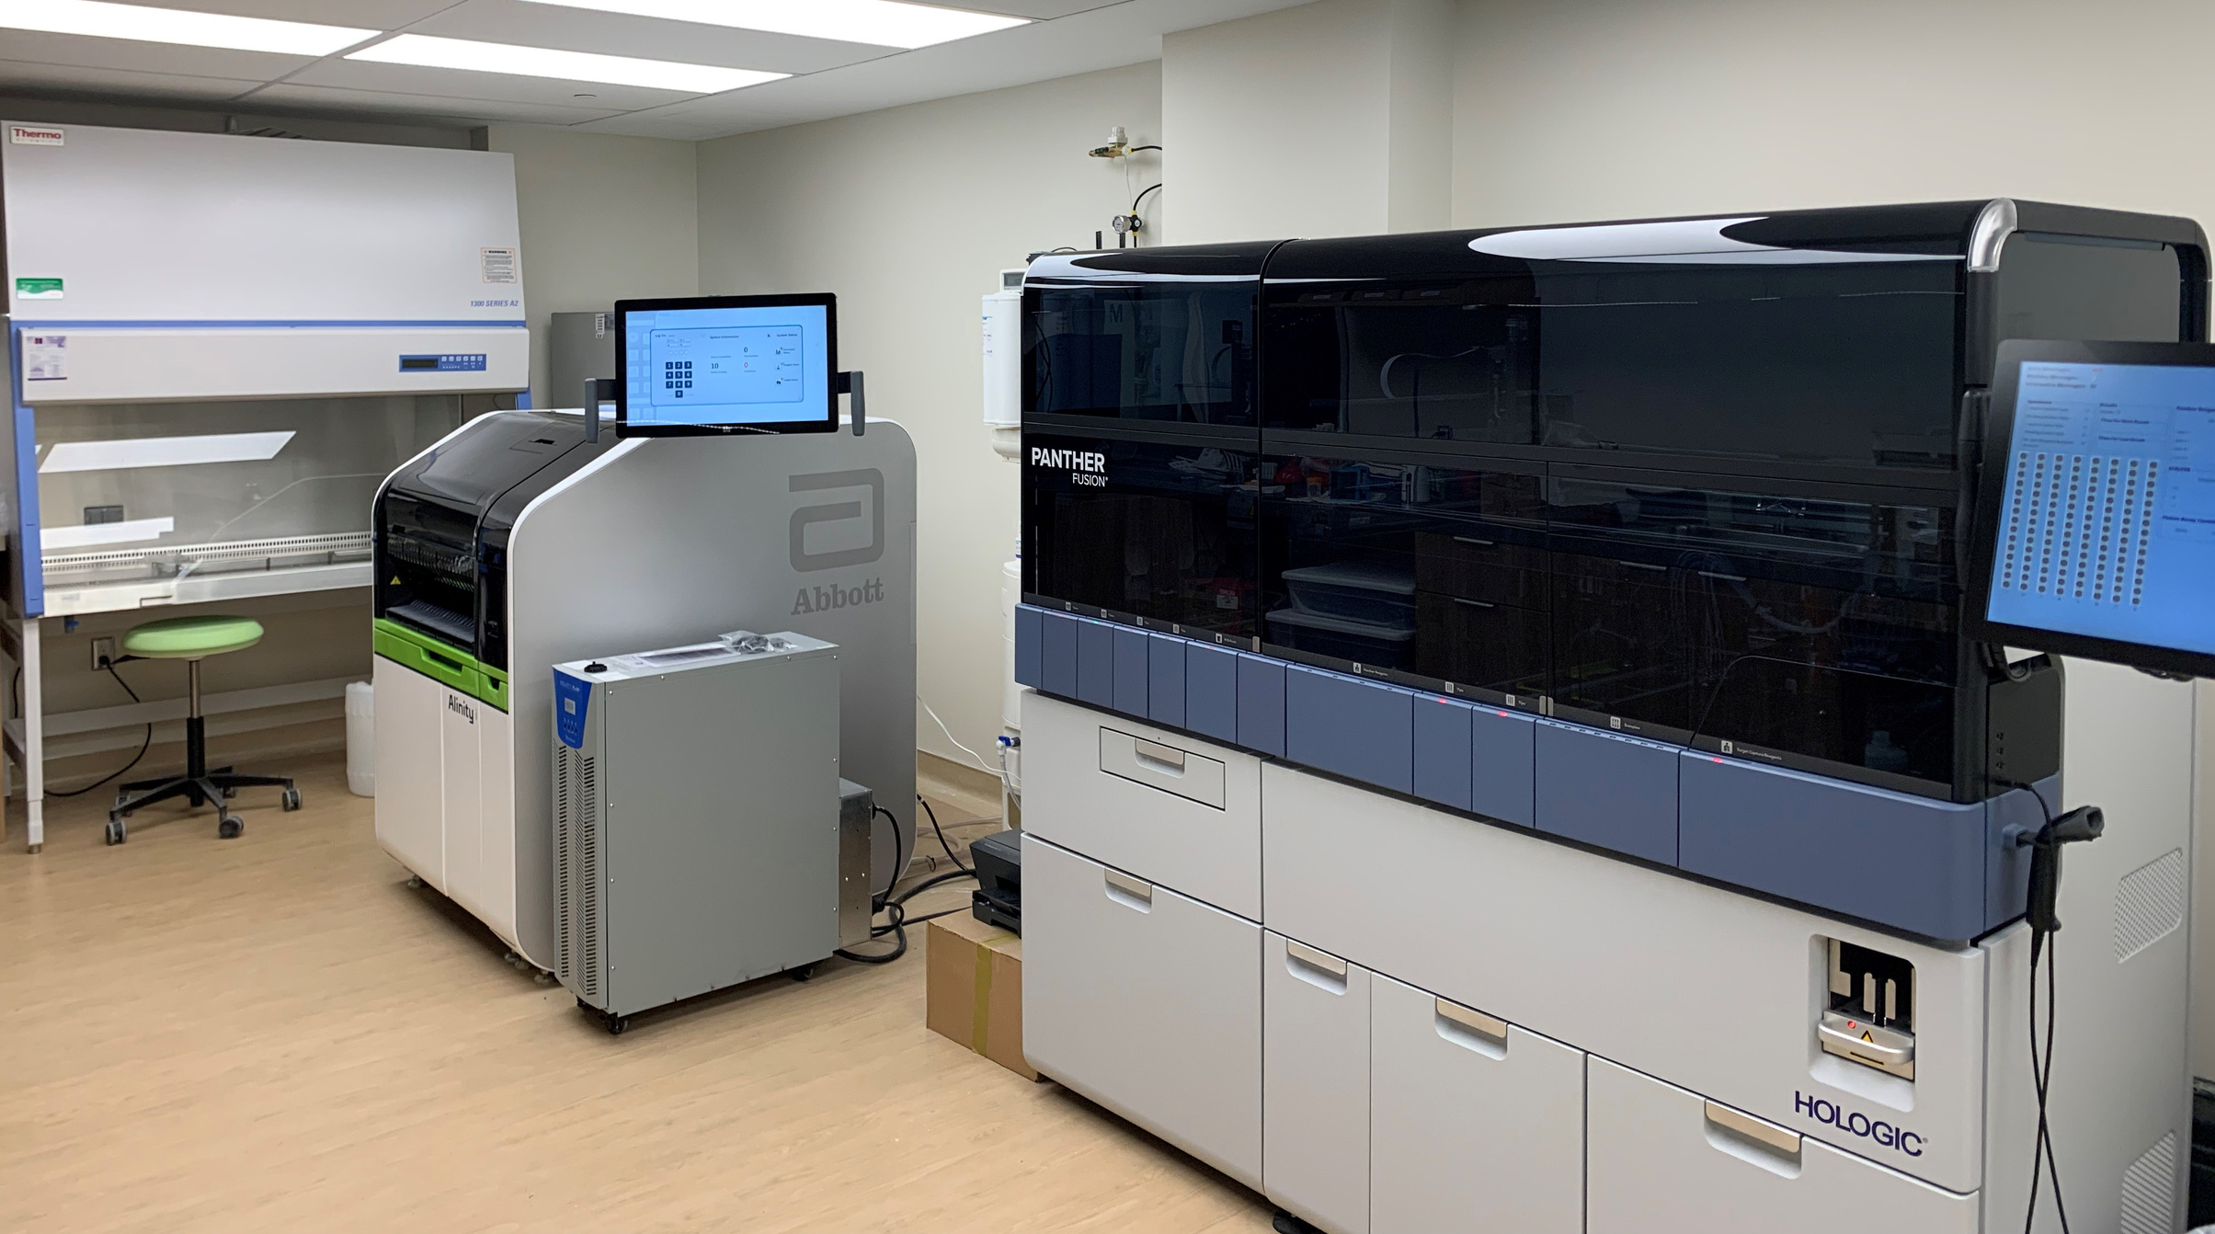
Improving the Health of Our Community
239,720 Test results
39,234 Treatment
@myhqtoronto | hqtoronto.ca | hqtoronto.ca/donate

Slide 15
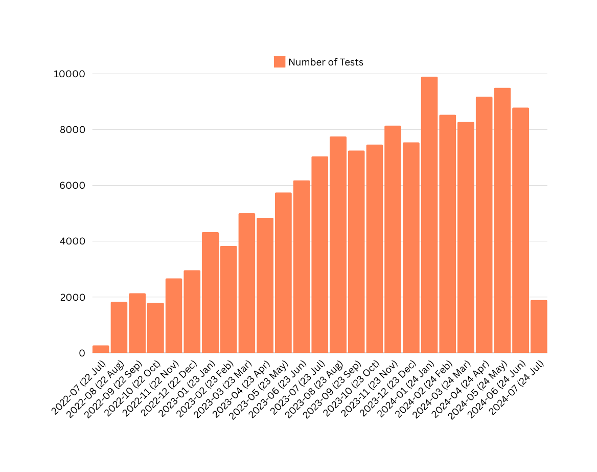
STBBI Testing- Overall
Overall Numbers
@myhqtoronto | hqtoronto.ca | hqtoronto.ca/donate

Slide 16
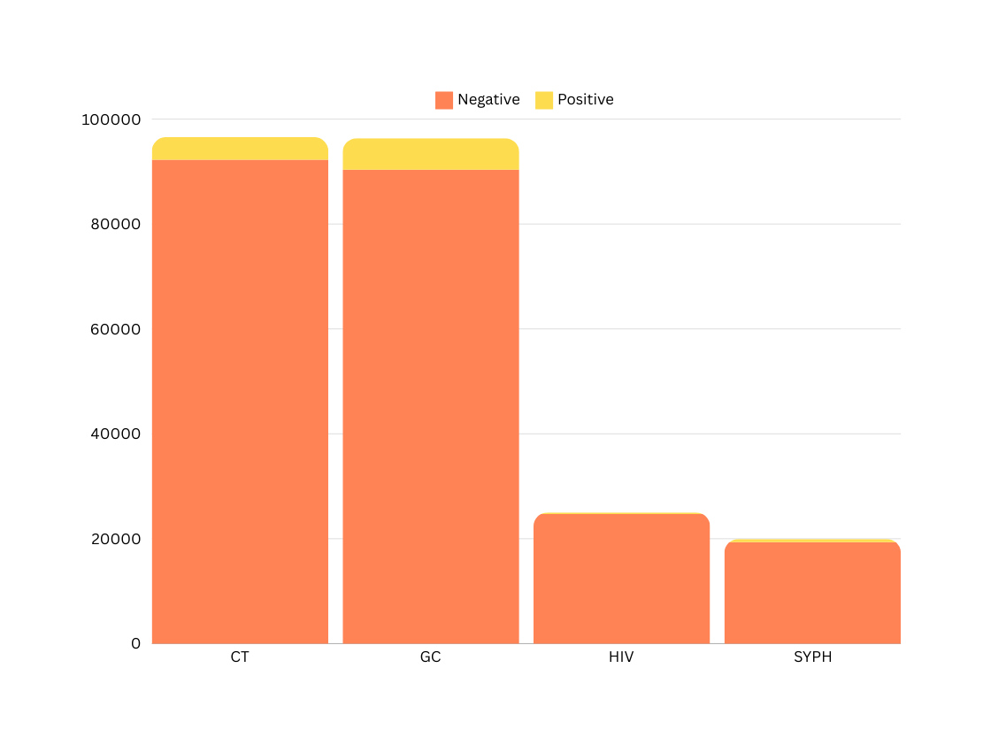
STBBI Testing
4303
6017
318
606
@myhqtoronto | hqtoronto.ca | hqtoronto.ca/donate

Slide 17
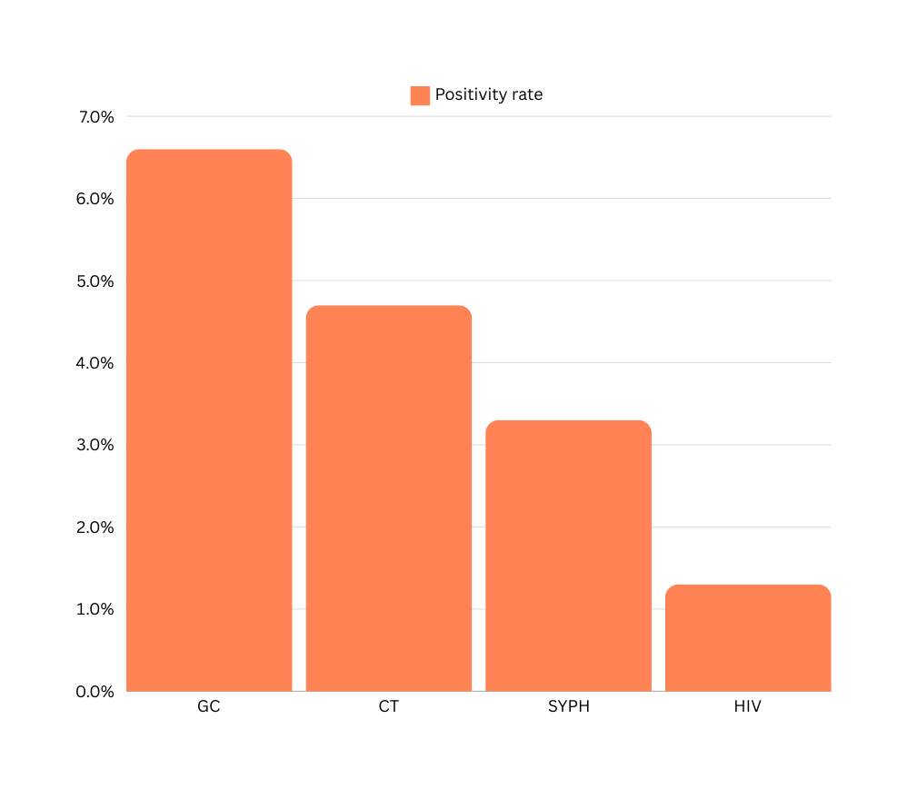
Positivity Rate
July 2022-June 2024
6.2%
4.5%
3.0%
1.3%
@myhqtoronto | hqtoronto.ca | hqtoronto.ca/donate

Slide 18
June 2024
Per Test Cost
 | Cost / Test | Test Volumes | Labour cost / Test | July Total Cost / Test
HIV Ag/Ab Combo Assay | $1.85 | 1618 | $ 2.39 | $ 4.24
Syphilis TP Assay | $ 1.34 | 1293 | $ 2.39 | $ 3.73
Aptima Combo 2 | $9.50 | 5868 | $ 2.39 | $ 11.89
HIV-1 QuantDx | $25.00 | 12 | $ 2.39 | $ 27.39
@myhqtoronto | hqtoronto.ca | hqtoronto.ca/donate

Slide 19
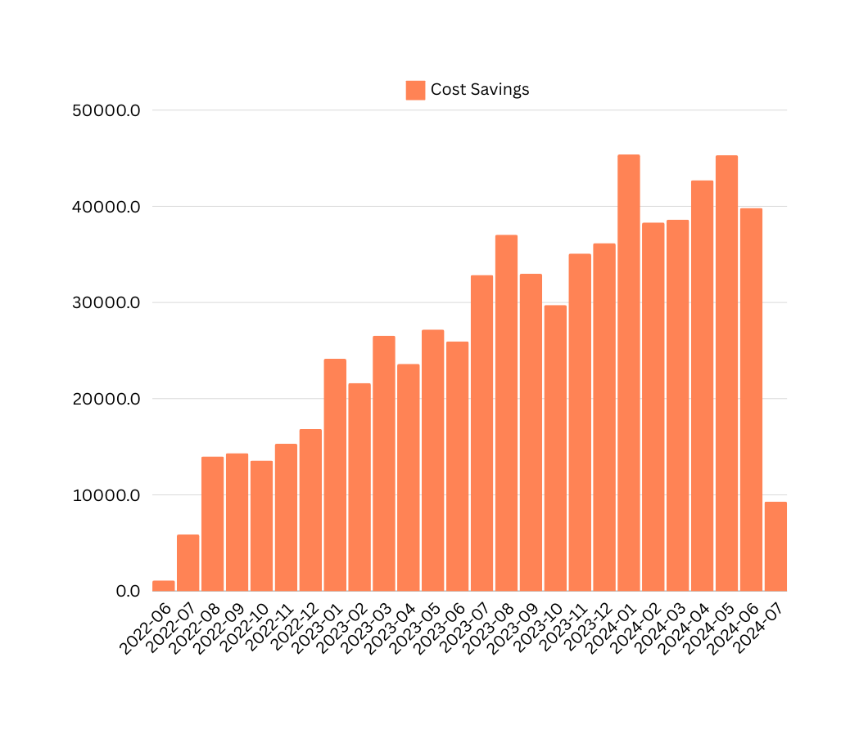
Monthly Cost Savings from Express Testing
Total cumulative savings to-date
$538,282
@myhqtoronto | hqtoronto.ca | hqtoronto.ca/donate

Slide 20

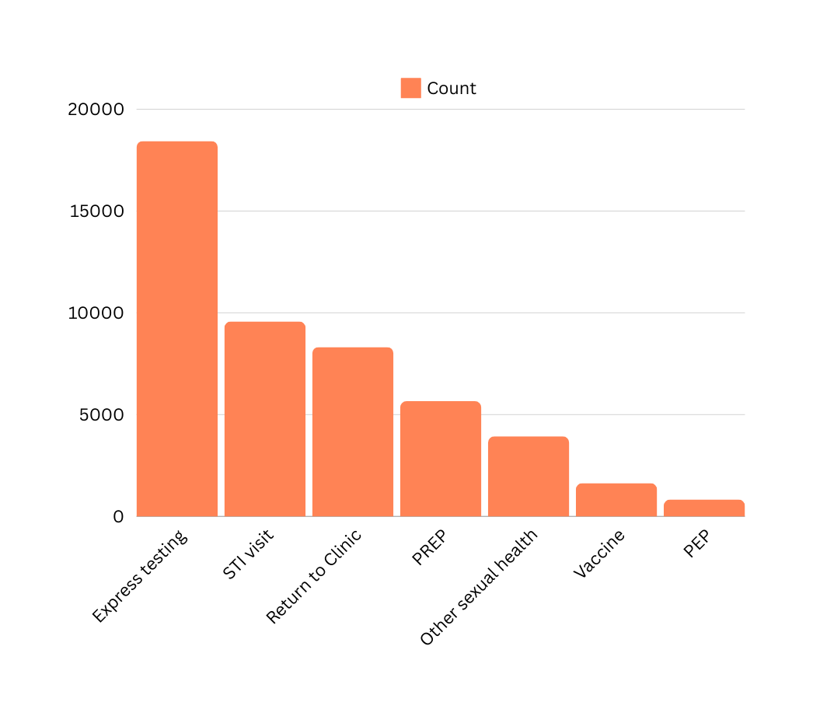
Reasons for Visit
July 2022 - June 2024
What individuals indicate on the kiosk as the reason for their visit
@myhqtoronto | hqtoronto.ca | hqtoronto.ca/donate

Slide 21

Unmet STBBI Needs
July 2022 - June 2024
2150 uninsured or precariously insured individuals accessing care at HQ (no OHIP or IFH)
2028 STBBIs diagnosed and treated amongst uninsured individuals
1321 gonorrhea or chlamydia
604 syphilis
2770 treatments given to 1212 service users (includes empiric treatments)
@myhqtoronto | hqtoronto.ca | hqtoronto.ca/donate

Slide 22


330 individuals with no OHIP, living with HIV receiving their HIV care at HQ
Unmet HIV Needs
July 2022 - June 2024
@myhqtoronto | hqtoronto.ca | hqtoronto.ca/donate

Slide 23

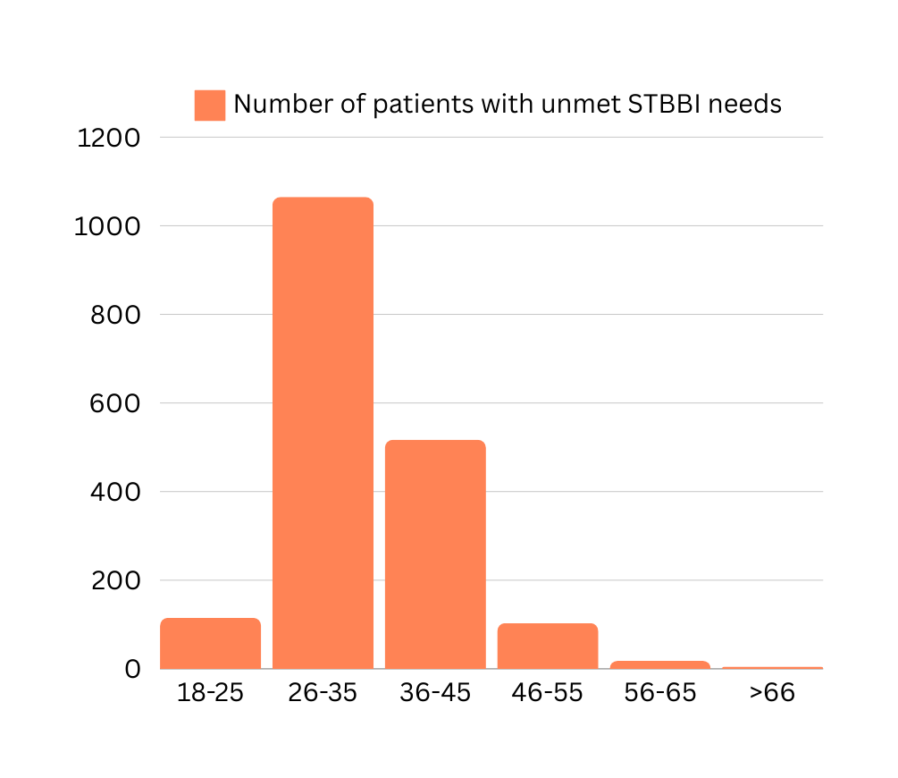
Unmet STBBI Needs: Age
Number of individuals
@myhqtoronto | hqtoronto.ca | hqtoronto.ca/donate

Slide 24

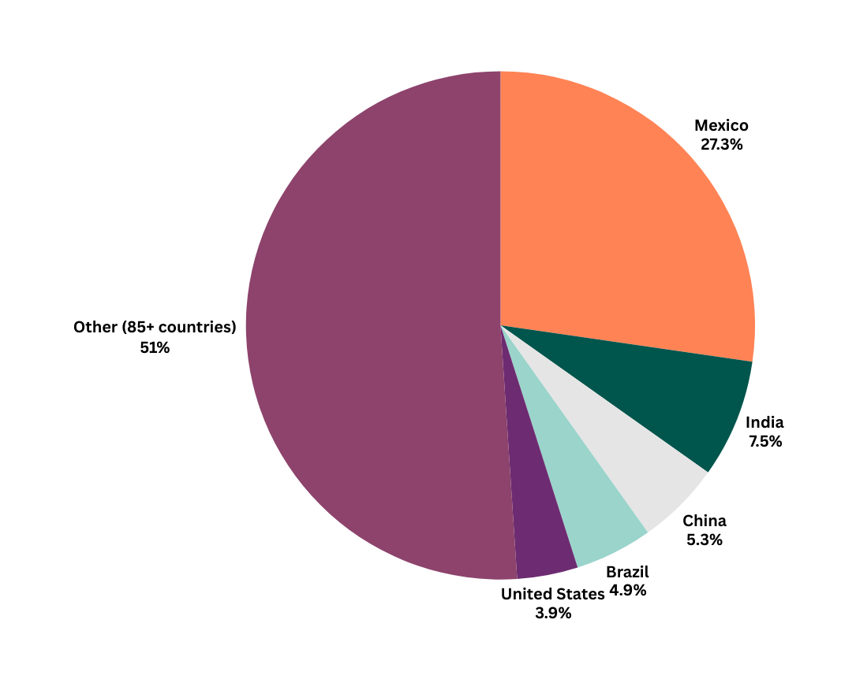
Unmet STBBI Needs: Country of Origin
Other countries of origin (individuals): Ukraine, Saudi Arabia, Peru, Barbados, Thailand, Cyprus, Hungary, Venezuela, Germany, South Korea, Spain, France, Uganda, Nigeria, Guyana, Ghana, Panama, Australia, Jamaica, Pakistan
@myhqtoronto | hqtoronto.ca | hqtoronto.ca/donate

Slide 25
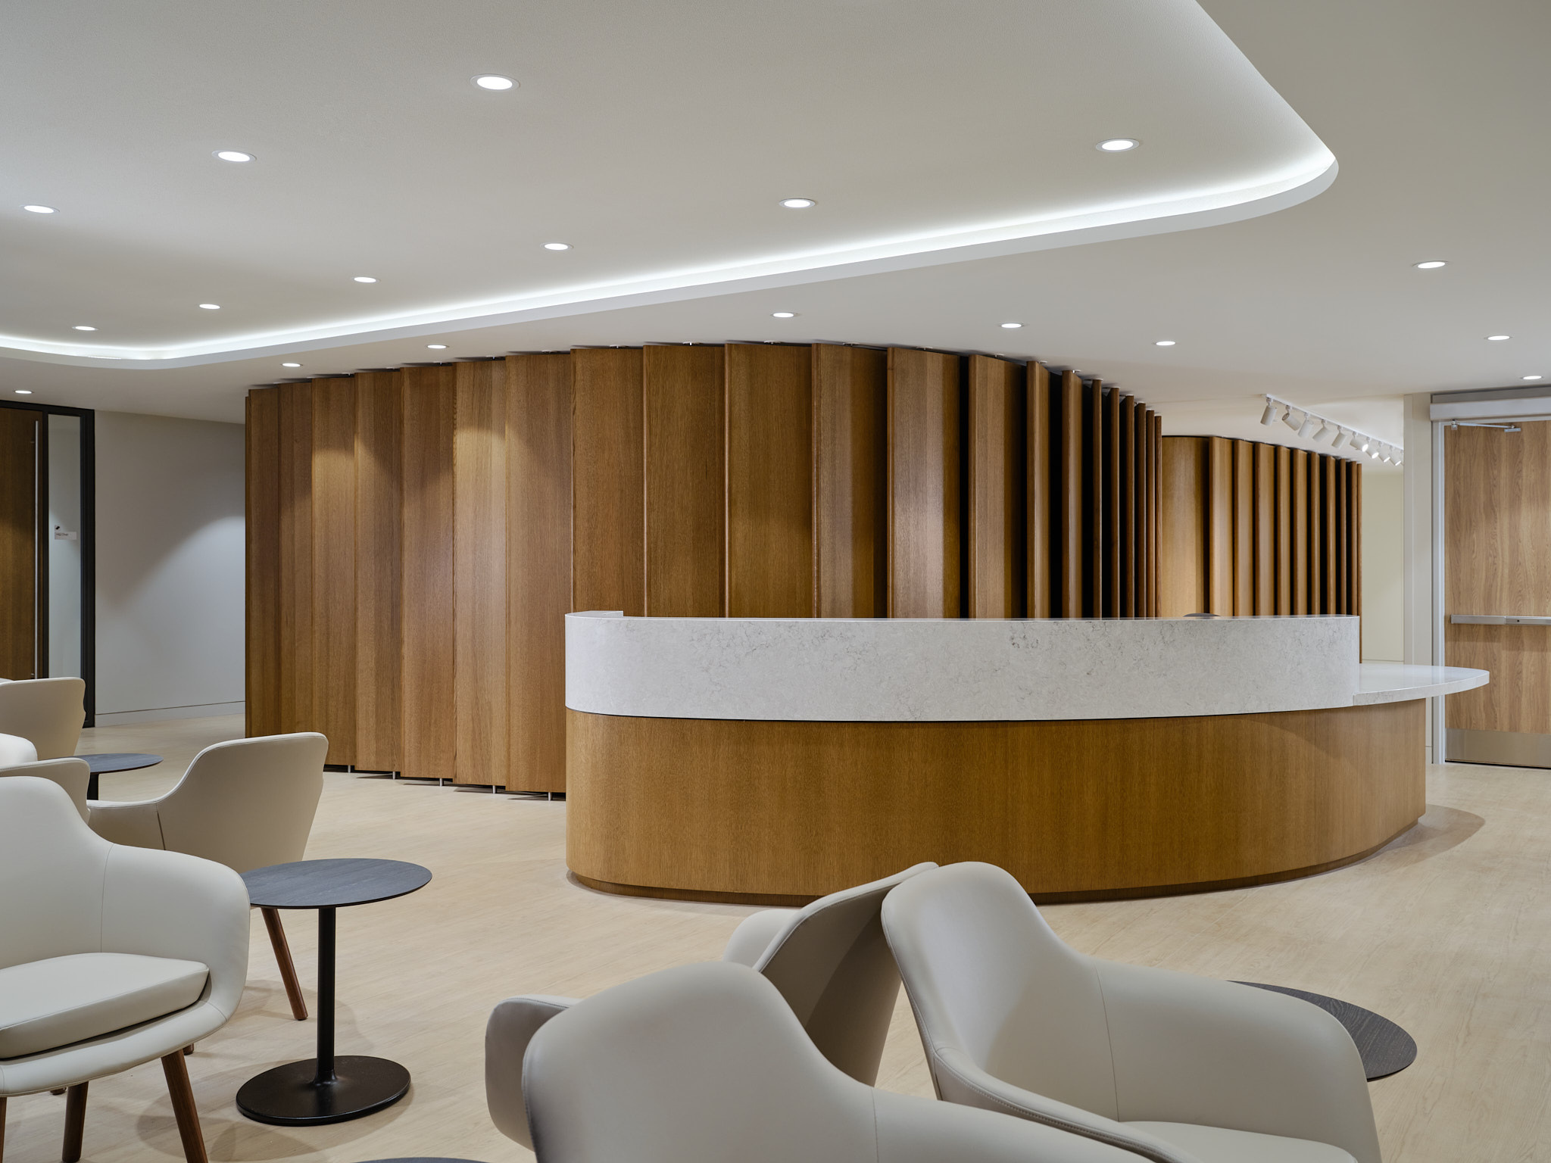
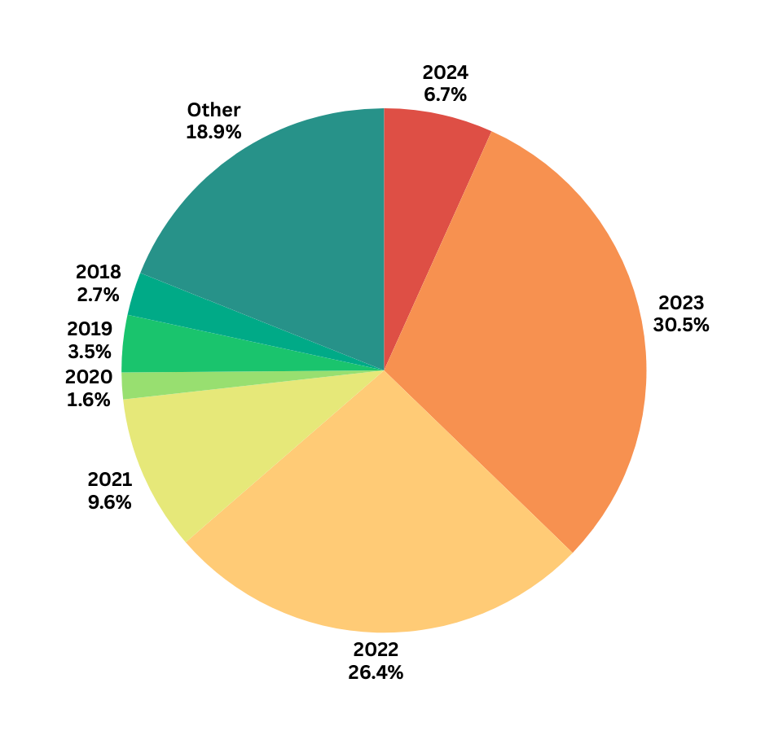
Unmet STBBI Needs: Year of Arrival in Canada
@myhqtoronto | hqtoronto.ca | hqtoronto.ca/donate

Slide 26

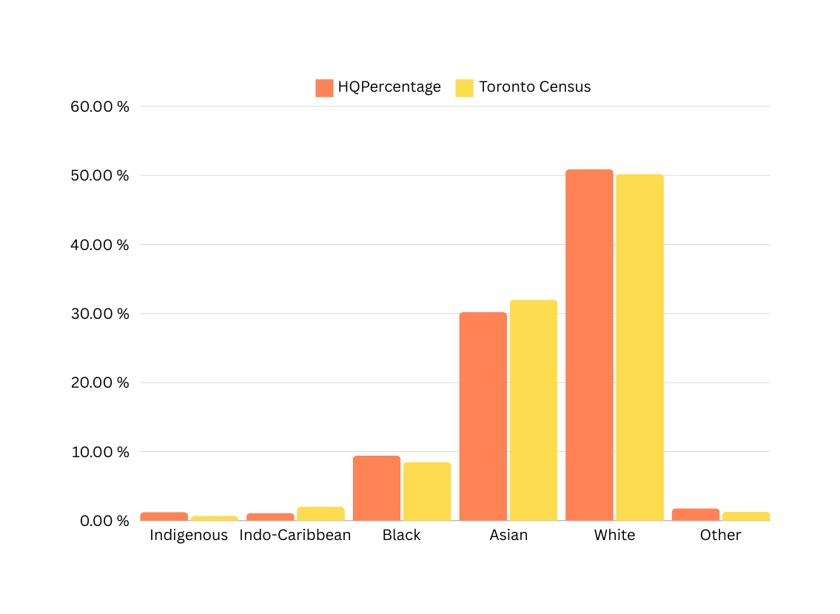
Ethnicity, by individual
Corrected for increases in Latinx, Mixed and Middle Eastern individuals by removing over-represented groups then re-calculating percentages
@myhqtoronto | hqtoronto.ca | hqtoronto.ca/donate

Slide 27
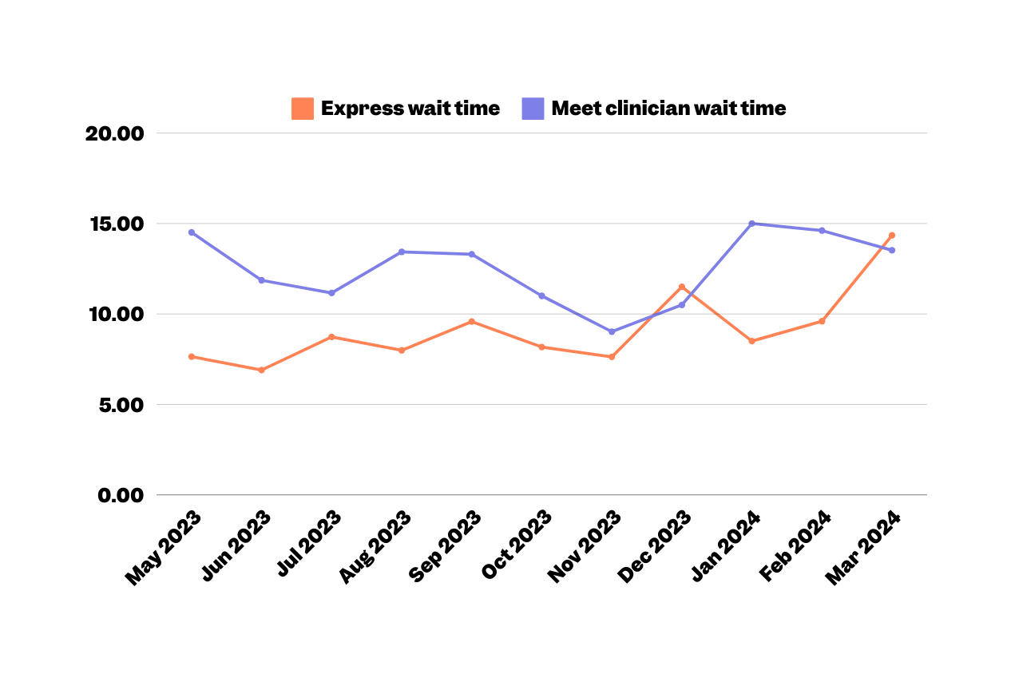
Outcome PREM -Visit Time
May - January 2024
DRAFT
Duration (minutes)
@myhqtoronto | hqtoronto.ca | hqtoronto.ca/donate

Slide 28

“Me siento muy afortunado de tener cerca a una clinica tan vanguardista como HQ”
"I feel very fortunate to have a state-of-the-art clinic like HQ nearby."
- Anonymous survey 2
“I was very happy with all the caring and attention. Great job guys"
- Anonymous survey 3
@myhqtoronto | hqtoronto.ca | hqtoronto.ca/donate

Slide 29
Patient Experience
March 2022 to January 2024
 | Score (out of 5) 599 surveys out of 28,939 sent Response rate 2.1% | % Negative reviews 😠(1/5) 🙁(2/5) | % Neutral reviews 😐(3/5)
Overall Experience | 4.81 / 5 | 2.2% | 1.5%
Efficiency | 4.78 / 5 | 2.5% | 2.2%
Welcoming | 4.78 / 5 | 2.7% | 1.7%
Recommend to a friend | 4.88 / 5 | 1.5% | 0.8%
“I feel completely safe understood and that I can speak freely about my medical needs as a gay man. I have never felt that before in a medical facility.”
- Anonymous survey
@myhqtoronto | hqtoronto.ca | hqtoronto.ca/donate

Slide 30
Patient Experience
December 2023
 | Score (out of 5) 55 surveys out of 2,550 sent Response rate 2.2% | % Negative reviews 😠(1/5) 🙁(2/5) | % Neutral reviews 😐(3/5)
Overall Experience | 4.84 / 5 | 1.8% | 1.8%
Efficiency | 4.89 / 5 | 1.8% | 0%
Welcoming | 4.80 / 5 | 3.6% | 0%
Recommend to a friend | 4.90 / 5 | 1.8% | 0%
"Pienso que en verdad fue un ecxelente servicio, muy amables y me atendieron rapido"
I think it was truly excellent service, very kind, and they attended to me quickly.
- Anonymous survey
@myhqtoronto | hqtoronto.ca | hqtoronto.ca/donate

Slide 31
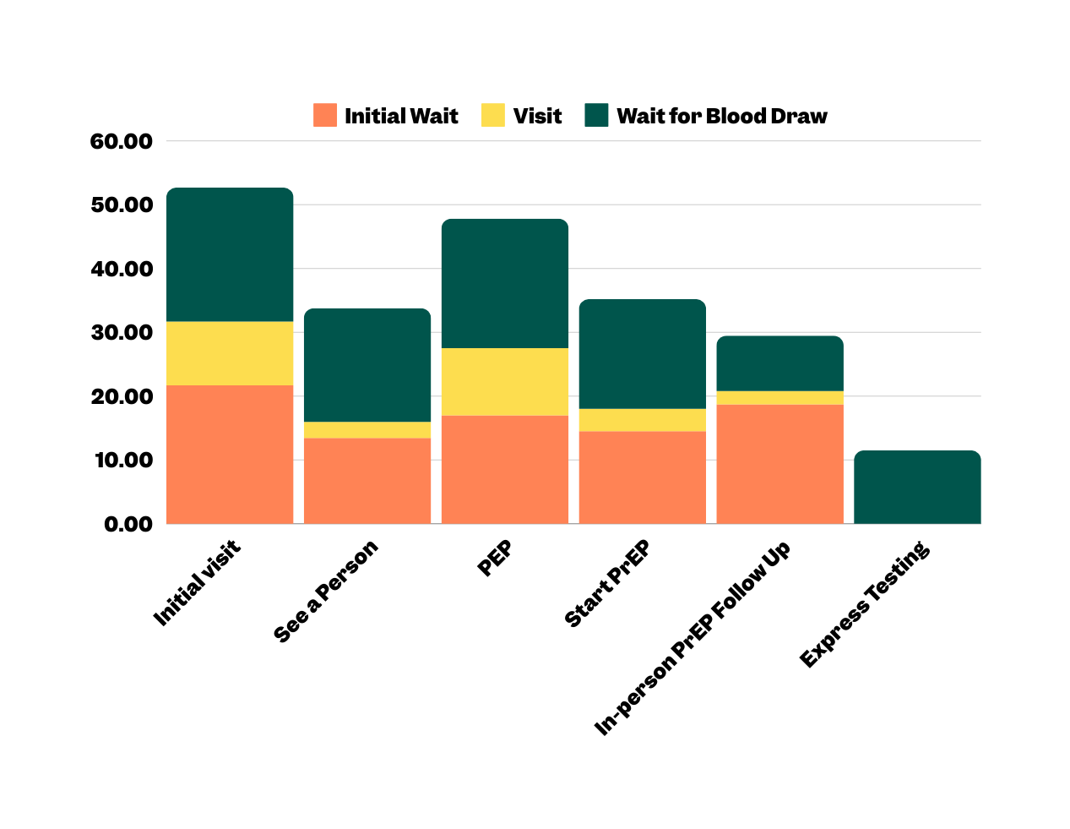
Outcome PREM -Visit Time
May - January 2024
Duration (minutes)
@myhqtoronto | hqtoronto.ca | hqtoronto.ca/donate

Slide 32

J’ai une excellente apprécions l’endroit et moderne et propre les toilettes sont futuriste et le personnel est professionnel c’est une merveilleuse addition pour la communauté gay
"I have an excellent appreciation for the place; it's modern and clean, the toilets are futuristic, and the staff is professional. It's a wonderful addition to the gay community."
- Anonymous survey 4
@myhqtoronto | hqtoronto.ca | hqtoronto.ca/donate
- Anonymous survey 3

Slide 33

Delivering care efficiently and economically
@myhqtoronto | hqtoronto.ca | hqtoronto.ca/donate

Slide 34

“The nurse was ... amazing.
Calmed me right down knew I was going through it and I couldn’t ask for better care”
- Anonymous survey regarding HIV Care
@myhqtoronto | hqtoronto.ca | hqtoronto.ca/donate

Slide 35
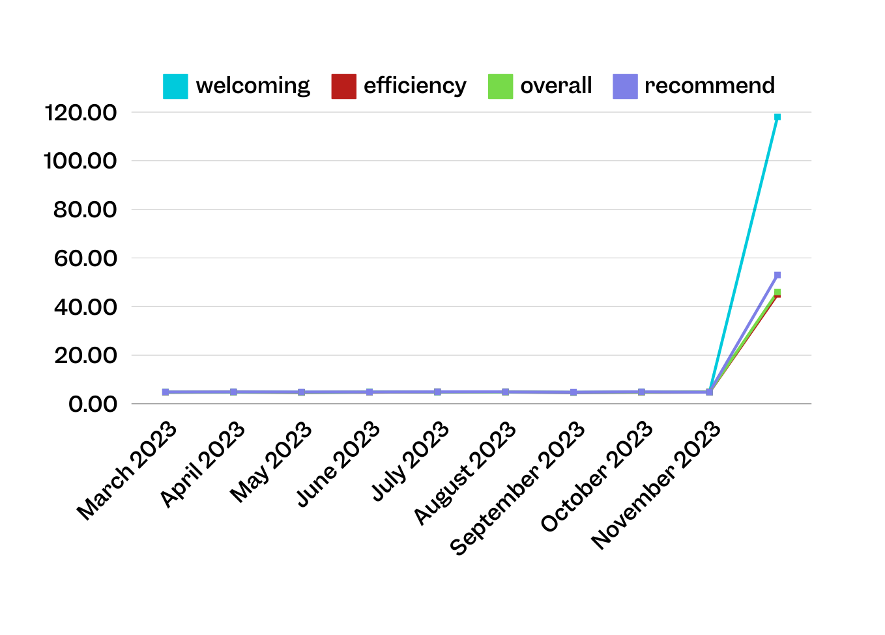
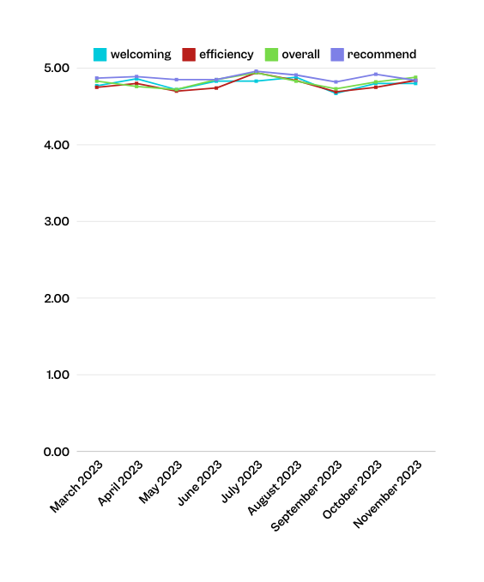

Patient Experience
March 2022 to January 2024
n
118 | 45 | 46 | 53 | 48 | 64 | 51 | 61 | 25
@myhqtoronto | hqtoronto.ca | hqtoronto.ca/donate
10

Slide 36
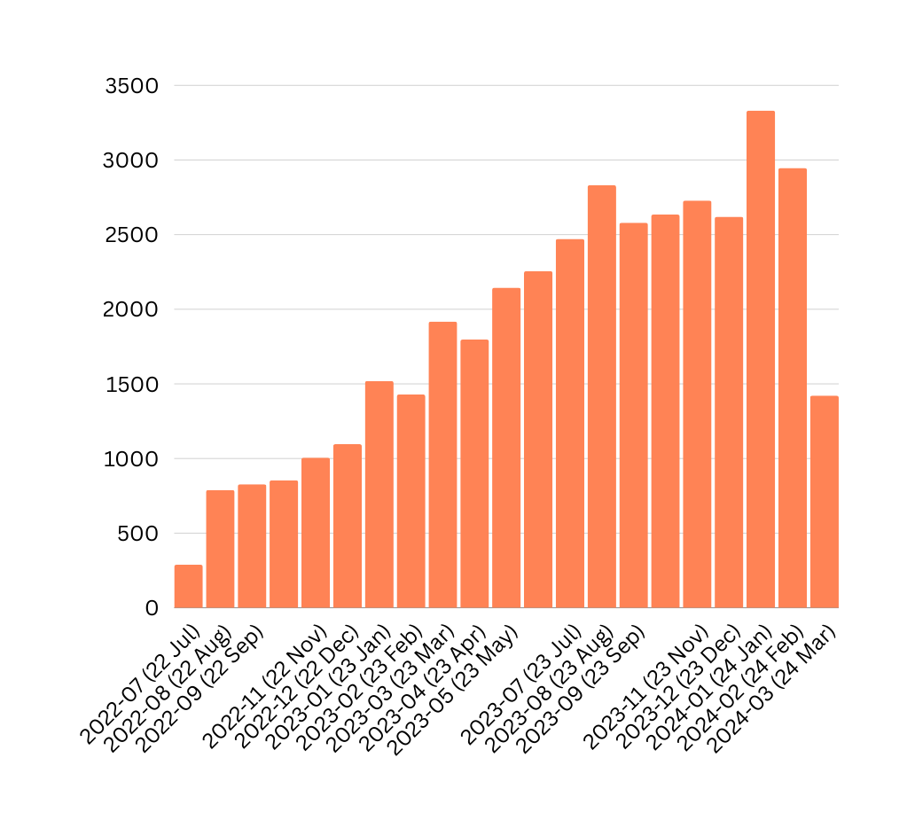

Total Visits to HQ
July 2022 to March 2024
4,725 visits in 2022
27,025 visits in 2023
7,699 visits in 2024

Slide 37

Outcome PREM -Visit Time
May - January 2024
DRAFT
Duration (minutes)
12

Slide 38
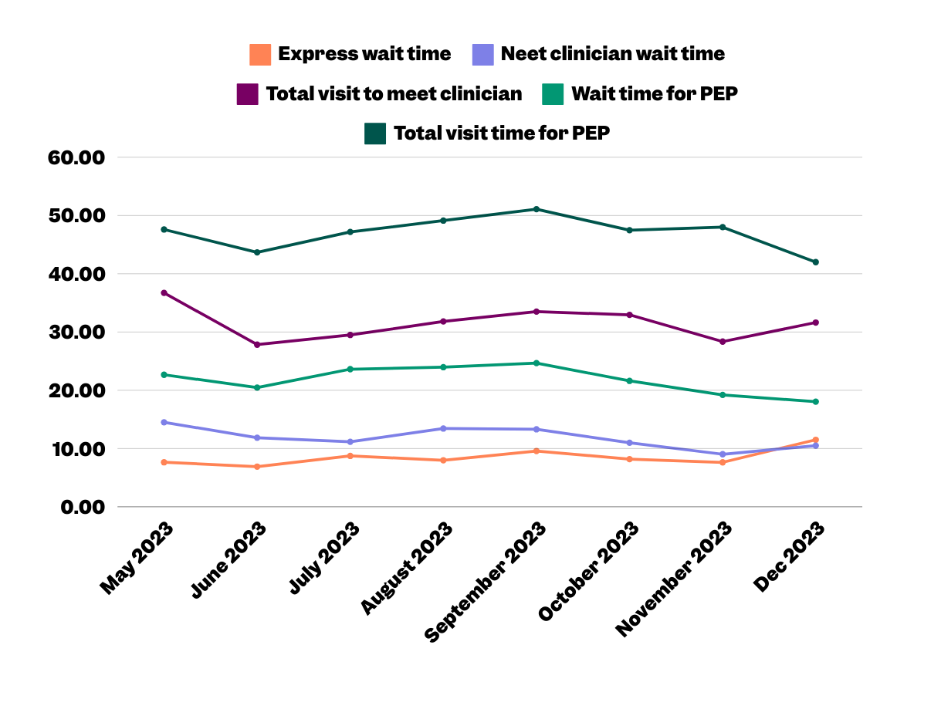
Outcome PREM -Visit Time
May - January 2024
DRAFT
Duration (minutes)
12

Slide 39
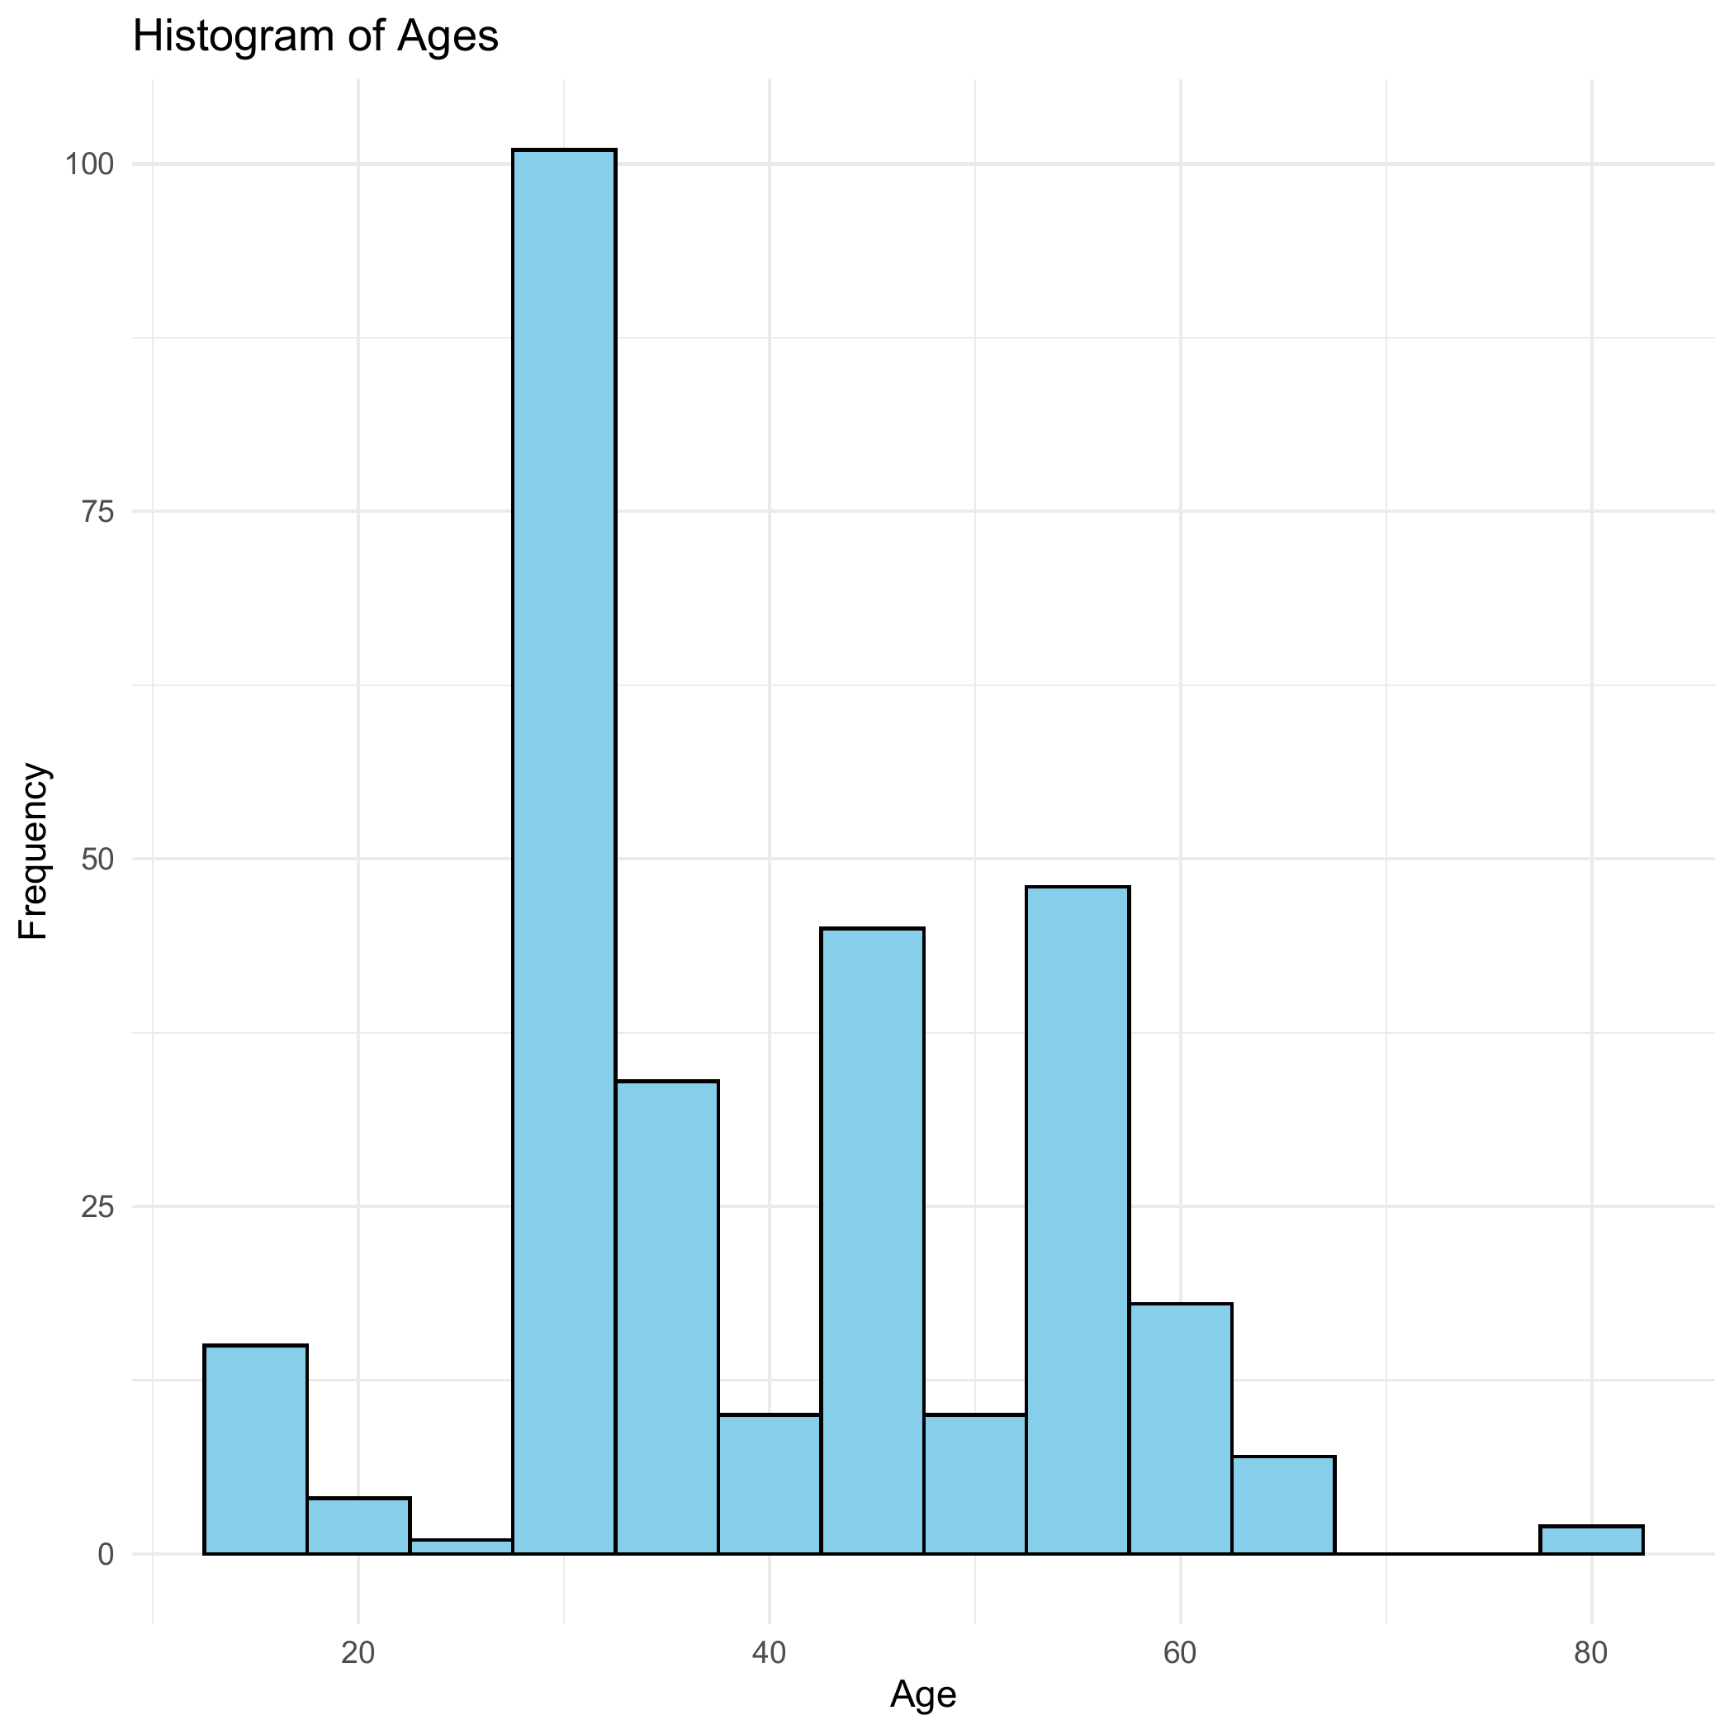
Testing new slide added
October 03, 2024
This is exciting!!!
Blablablablabla

Slide 40
Testing new slide added
October 03, 2024
This is exciting!!!
Blablablablabla

Slide 41
35
30
25
mpg
20
15
10
2
3
wt
4
5

Slide 42
35
30
25
mpg
20
15
10
2
3
wt
4
5

